Slide 1
Mobile Communication and Internet Technologies
Disruptive Technologies and Internet of Things
Courtesy of:
Dr Payam Barnaghi, Dr Chuan H Foh ,UB Desi
University of Surrey and IIT-Bombay
http://web.uettaxila.edu.pk/CMS/AUT2014/teMCITms/

Slide 2
Module Aims
The main aims of this module is to:
  Introduce Disruptive Technologies, examples and way forward
  Introduce the fundamental concepts of the Internet of Things and its applications and architecture models;
  Introduction to the technologies and mechanisms for sensing, actuation, processing and cyber-physical data communication.

Slide 3
What is disruptive technology?
Working Definition:
  Technology which creates a major (positive) disruption in the way society functions
Best explicated thru examples

Slide 4
Disruptive Technology:
Famous Incorrect Predictions
“What could be more palpably absurd than the prospect of locomotives traveling twice as fast as stagecoaches” The Quarterly Review, March 1825
“The horse is here to stay, but the automobile is only a novelty – a fad” Advice to Henry Ford’s Lawyer, 1922
“Well informed people know that it is impossible to transmit the voice over wires and were that it were possible to do so, it would be of no practical value” Editorial in the Boston Post, 1865
“This telephone has too many shortcomings to be seriously considered as a means of communication. The device is inherently of no value to us.” Western Union Internal Memo, 1876

Slide 5
Disruptive Technology:
Famous Incorrect Predictions
“The wireless music box has no imaginable commercial value. Who would pay for a message sent to nobody in particular?” Response of Associates of David Sarnoff, when invited to invest in radio
“I think there is a market for about five computers.”
Thomas Watson, Sr. Founder of IBM, 1943
“There is no reason anyone would want a computer in their home.” Ken Olsen, President and Founder of Digital Equipment Corp., 1977
“640k ought to be enough for anybody”
Attributed to Bill Gates in 1981

Slide 6
Disruptive Technology:
Famous Incorrect Predictions
A cookie store is a bad idea. Besides, the market research reports say America likes crispy cookies, not soft and chewy cookies like you make. --Response to Debbi Fields' idea of starting Mrs. Fields' Cookies.
Airplanes are interesting toys but of no military value. --Marechal Ferdinand Foch, Professor of Strategy, Ecole Superieure de Guerre (Royal Military Academy (Belgium)).
But what ... is it good for? --Engineer at the Advanced Computing Systems Division of IBM, 1968, commenting on the microchip.
Computers in the future may weigh no more than 1.5 tons. --Popular Mechanics, forecasting the relentless march of science, 1949
Drill for oil? You mean drill into the ground to try and find oil? You're crazy. --Drillers who Edwin L. Drake tried to enlist to his project to drill for oil in 1859.
Everything that can be invented has been invented. --Charles H. Duell, Commissioner, U.S. Office of Patents, 1899.
Notes:
http://en.wikipedia.org/wiki/Edwin_Drake

Slide 7
Disruptive Technology:
Famous Incorrect Predictions
People predict the future incorrectly because the “wrong” answer makes sense at the time
  Watson could not have know about:
    Miniaturization
    Networking
    The Internet
    User friendly, graphical user interfaces
    Falling costs of computer components

Slide 8
Technologies
Sustaining – Steady, linear improvement of existing technology
Disruptive – Introduction of completely new approaches that have the potential to create a new industry or transform an existing one
  Revolutionary – radical innovations
    digital photography, micro-bots, high-temperature superconductors
  Evolutionary – formed by the convergence of previously separate research areas
    MRI imaging, faxing, electronic banking

Slide 9
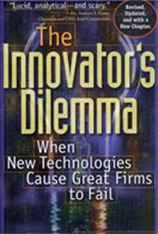
The Innovator’s Dilemma
The best of conventional good business practices can ultimately weaken a great firm
from “The Innovator’s Dilemma”, by Clayton M. Christensen, Harvard Business School Professor, on technological innovation and disruptive technologies
Notes:
http://www.claytonchristensen.com/books/the-innovators-dilemma/

Slide 10
The Innovator’s Dilemma
The PC is a prime example of a "disruptive technology" that was dismissed out of hand by an industry's established leaders until it was too late.
Disruptive technologies work by offering, at least initially, little in the way of performance, but plenty in terms of cheapness, convenience and ease of use.
  As such, they appeal to a different class of customers, carving out new markets for themselves before going on to have the industrial Goliaths' business for lunch.

Slide 11
The Innovator’s Dilemma
The Innovator's Dilemma: A company which is in an existing business and listening to its existing customers feels that there is no need for anything new.
Should it invest its money to
  make new products that its best customers can use and that would improve the company’s profit margins" or
  invest its money to create worse products that none of its customers can use, that would wreck its profit margins.
    Sustaining technologies – meet the needs of customers today and the ones who are paying
    Disruptive technologies – come from innovators who keep improving the product performance till it comes "from below" and starts hurting the entrenched incumbents.

Slide 12
Dilemmas of Disruptive Technology
Established Market Technology Trajectory
Emerging Market Technology Trajectory
performance demanded at the high end of the market
PERFORMANCE
Disruptive technology
New performance trajectory
performance demanded at the low end of the market or in a new emerging market
TIME

Slide 13
Disruptive Technology
The sustaining technologies are on the blue arrow e.g., incremental engineering advances that all good companies are able to grind out.
The downward yellow arrow, a disruptive technology, is something that brings to the market a product or service that is not as good as what historically had been available, and therefore it can't be valued or used by customers in the mainstream of the market. Yet it takes root in a different application.
The green arrow represents the new performance trajectory - it slopes upward faster than the sustaining technology and intersects with the customers needs and the mainstream.

Slide 14
Innovator’s Dilemma
Disruptive technologies do not initially satisfy the demands of even the high end of the market.
Large companies choose to overlook disruptive technologies until they become more attractive profit-wise.
Eventually they surpass sustaining technologies in satisfying market demand with lower costs.
Large companies who did not invest in the disruptive technology sooner are left behind.

Slide 15
Disruptive Technologies
Well-established companies have problems dealing with disruptive technologies because they aren't prepared to handle the changes they bring on.
  Christensen defines disruptive technologies as "simple, convenient-to-use innovations that initially are used by only unsophisticated customers at the low end of markets."
Large companies tend not to pay attention to these disruptive technologies because they don't satisfy the demands of high-end users -- at least, not at first.
  But because these radical innovations initially emerge in small markets, they can, and often do, become full-blown competitors for already established products
  If a company is prepared to deal only with "sustaining technologies," or technologies that improve product performance, and not disruptive technologies, it can fail.

Slide 16
Digital Equipment Corporation
Although it was considered one of the best companies in the 1970s and 1980s, Digital was destroyed by a disruptive technology -- the PC
During the mid-1980s, Digital kept pace with users' demands for increased amounts of computing power. As the company continued to supply this power, it also continued to lower prices.
The well-managed Digital appeared to be on the road to complete dominance of its market.
Introduced by a few start-ups, the PC appealed to individuals, not enterprises, who wanted to use them mainly to play games.
In 1977, Ken Olsen, the founder and CEO of Digital Equipment Corporation, said, "There is no reason for any individual to have a computer in his home."
DEC decided not to invest time, or money, in a product its customer companies didn't want. Digital's management continued to invest in its high-end products.
The rest is history. Digital's customers decided they didn't want to pay high prices for its products when the PC was cheaper and performed adequately. Digital was done in by a disruptive technology it failed to recognize.

Slide 17
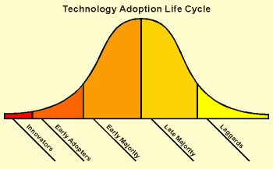
Technology Adoption Lifecycle Curve
“Crossing the Chasm”, Geoff Moore
The curve is loosely divided into 5 segment: Innovators, Early Adopters, Early Majority, Late Majority and lastly Laggards.
The area under the curve can be interpreted as the User Expectations from the technology.
  The more mature the technology, the higher the user expectations.
  The laggards are the most difficult customers often requiring the most resources - most companies adopt the 80/20 rule.

Slide 18
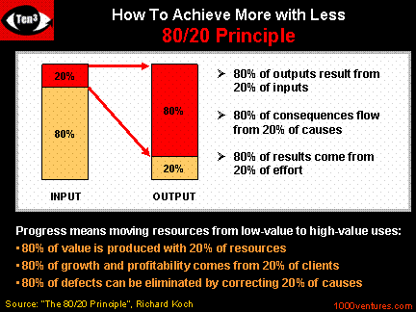
80/20 Rule
Innovation is absolutely critical to future competitive advantage and it can be easier by considering the following ideas:
80% of value perceived by customers relates to 20% of what your organization does
80% of the benefit from any product or service can be provided at 20% of the cost
80% of the profits made in your industry are made by 20% of firms. If you are not one of these, what are they doing right that you're not?

Slide 19
2/10 Rule of Technology Adoption
The 2-10 rule defines when a technology moves from the interesting and cool stage to the really useful.
The really useful stage is when you are willing to spend money to implement the technology products and services at your company.
Year 10
Useful Stage
Year 2
Cool Stage

Slide 20
2/10 Rule of Technology Adoption
Examples: fax machine; desktop PCs; operating systems; PDAs; GPS; mobile phones; email and ecommerce.
  All of these products and services were launched with great fanfare that touted the way they would revolutionize our lives. All of them failed to live up to their hype in the early days. But all of them have gone on to over-deliver on their original promises and expectations.

Slide 21
Historical Disruptive Technologies
What are some disruptive technologies that help civilization advance?

Slide 22
It’s In The Timing
Hit the market too early, then the product performance will not be adequate for the market to adopt it and it will fail e.g., the Apple Newton
The key lies in targeting a niche which will use the product and be delighted by it (as the Blackberry). As performance improves over time, it becomes ready for the mainstream.
The Internet is also an "enabling technology“
  The Internet has unleashed a wave of innovation. Along with the personal computer, it is perhaps the biggest disruptive technology that we have seen in our generation.
  The impact of the Internet is only beginning to be felt across many industries.
  As companies retool for web services, there will be dramatic change in the way enterprises interact with each other - collaborative commerce

Slide 23
Examples of Disruptive Tech.
  Sun Microsystems Workstations: disrupted the market for main frame computers.
  PCs disrupted the market for workstations
  Xerox plain paper copier: disrupted the market for offset printing.
  Cannon’s desktop photocopiers: disrupted Xerox’s high speed photo copying market.

Slide 24
Honda motorcycle of 60s
Japanese cars of 70s
Korean Cars of late 80s
Wireless telephony (GSM, CDMA): disrupted the market for wire-line telephony.
…

Slide 25
Impacting technologies are disruptive
  Disruptive innovations are products and services that initially aren't as good as those that historically have been used by customers in mainstream markets, and therefore can take root only in new or less-demanding applications, amongst non-traditional customers
  Stuart Hart and Clayton Christensen

Slide 26
Historically:
Major waves of growth
thru targeting the bottom
of the developed markets
(DM)
DM

Slide 27
The World Pyramid
Population in millions
Purchasing Power Parity (PPP)
>$20,000
Tier 1
~ 200 mil
Tier 2 & 3
~ 800 mil
$2000 to $20,000
less than $2000
Tier 4
~ 5000 mil

Slide 28
The Pyramid
Examples of Xerox, Cannon copiers, PCs, Cell phones, etc. represent technologies developed for the second Tier (to some extent Tier 3)
To date most disruptive technologies have been attacking Tier 2

Slide 29
Attack the bottom of the
pyramid. Likely to create
greater disruption
bottom of
the pyramid

Slide 30
Opportunities at the Bottom of the Pyramid
Nearly 4 to 5 billion world wide at the bottom of the pyramid
Need to develop new technologies for Tier T4 and T5
New business models are needed

Slide 31
Change of Mindset …
The Poor
population
is an
Intractable
Problem
The Poor
population
is a
Potential
Market
The Poor
population
can be
A Source of
Innovation
Poverty
Alleviation,
Subsidies
Creating a New Market,
Innovation, Growth

Slide 32
Challenges
The Market is Very Fragile:
Middlemen and Moneylenders
Fragmented Experiments
Lack of a Global database
Traditional Ways of Thinking

Slide 33
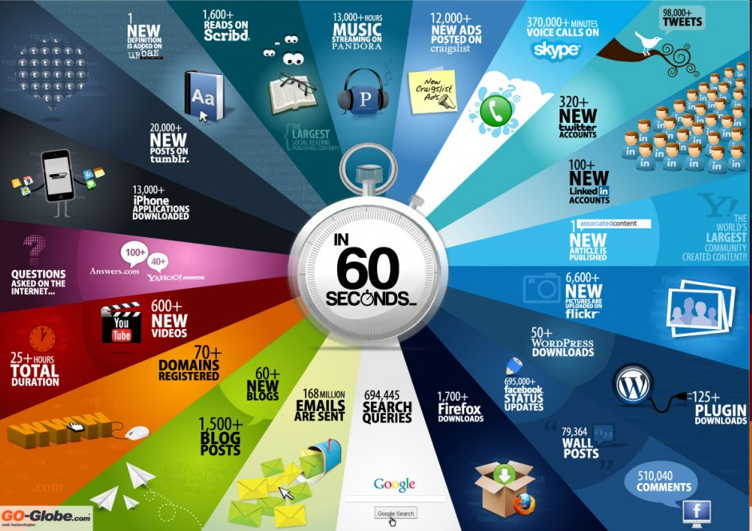

Slide 34
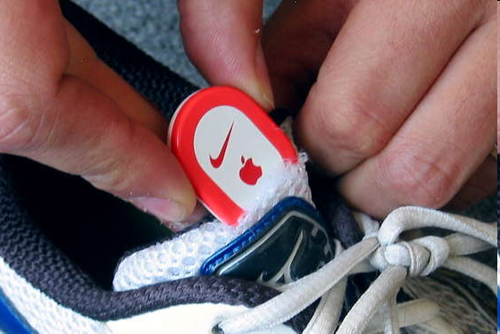
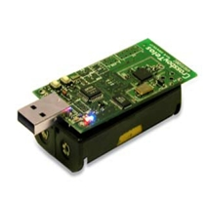
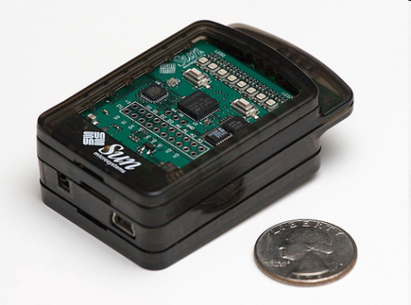
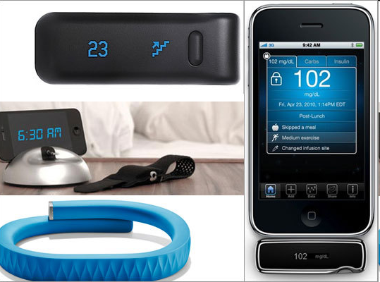
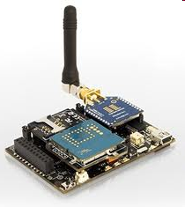
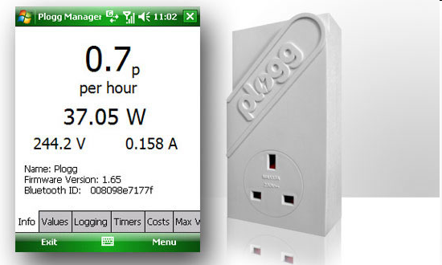

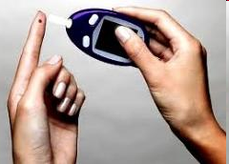
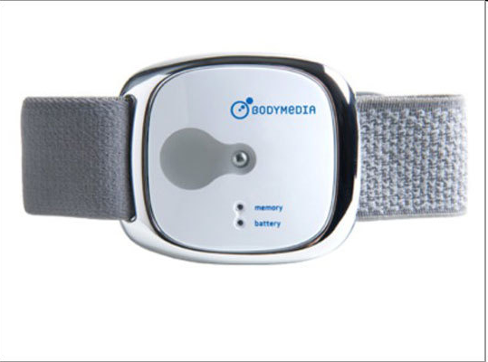
Sensor devices are becoming widely available
- Programmable devices
- Off-the-shelf gadgets/tools
Notes:
http://earthtechling.com/2010/11/plogg-smart-plug-tracks-energy-usage/
http://www.bodymedia.com/

Slide 35
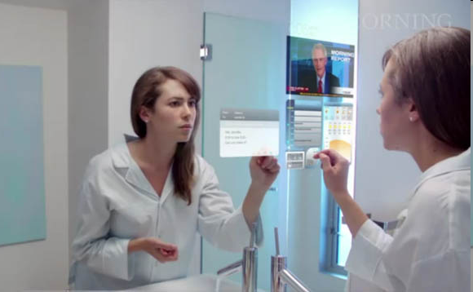
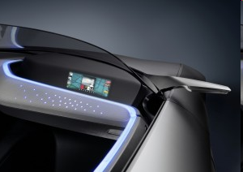
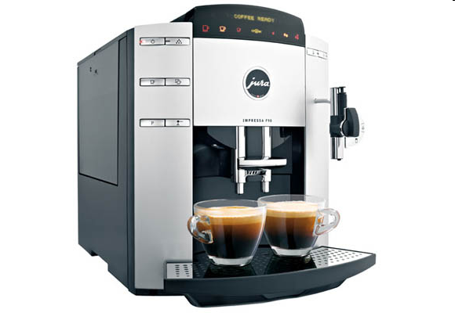
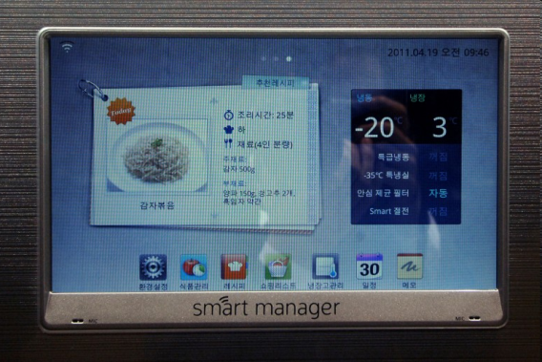
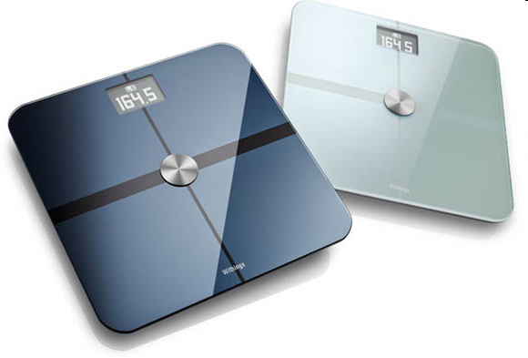
More “Things” are being connected
Home/daily-life devices
Business and
Public infrastructure
Health-care
…

Slide 36





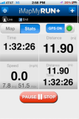
People Connecting to Things
ECG sensor
Internet
Motion sensor
Motion sensor
Motion sensor

Slide 37
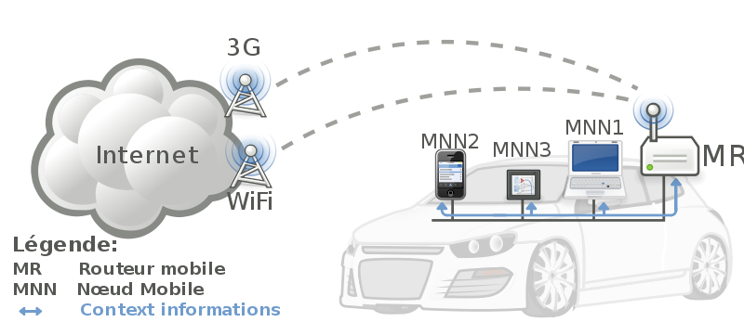



Things Connecting to Things
MR: Mobile Router
MNN: Mobile Node
- Complex and heterogeneous
resources and networks

Slide 38







Wireless Sensor Networks (WSN)
End-user
Core network
e.g. Internet
Gateway
Sink
node
Gateway
Computer services
The networks typically run Low Power Devices
Consist of one or more sensors, could be different type of sensors (or actuators)

Slide 39
How are the networks changing?
Extensions
  More nodes, more connections, IPv6, 6LowPan,...
  Any TIME, Any PLACE + Any THING
  M2M, IoT
    Billions of interconnected devices,
    Everybody connected.
Expansions
  Broadband
Enhancements
  Smart networks
  Data-centric and content-oriented networking
  Context-aware (autonomous) systems
Notes:
http://datatracker.ietf.org/wg/6lowpan/charter/
http://en.wikipedia.org/wiki/Machine_to_machine/
http://en.wikipedia.org/wiki/Internet_of_Things/

Slide 40
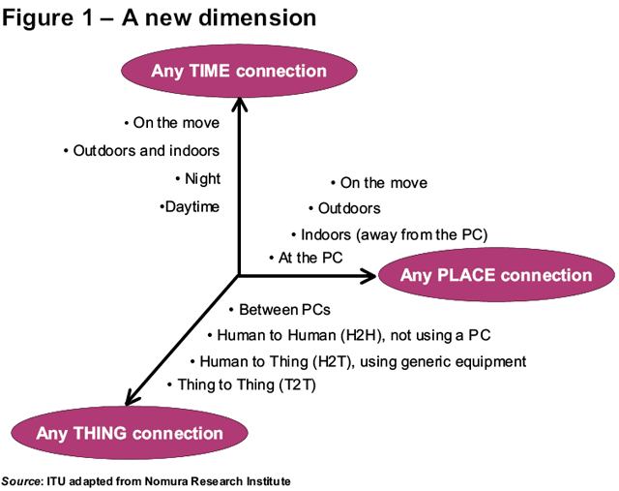
Future Networks

Slide 41
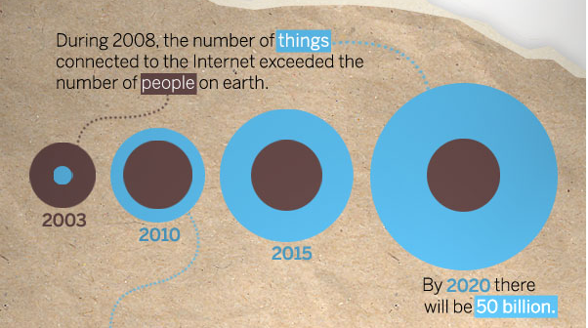
“Thing” connected to the internet
Image Courtesy: : CISCO

Slide 42
Internet of Things (IoT)
Extending the current Internet and providing connection, communication, and inter-networking between devices and physical objects, or "Things," is a growing trend that is often referred to as the Internet of Things.
“The technologies and solutions that enable integration of real world data and services into the current information networking technologies are often described under the umbrella term of the Internet of Things (IoT)”

Slide 43
Why should WE learn about IoT?
Business trend
Emerging technologies
Growing IoT Services and Application

Slide 44
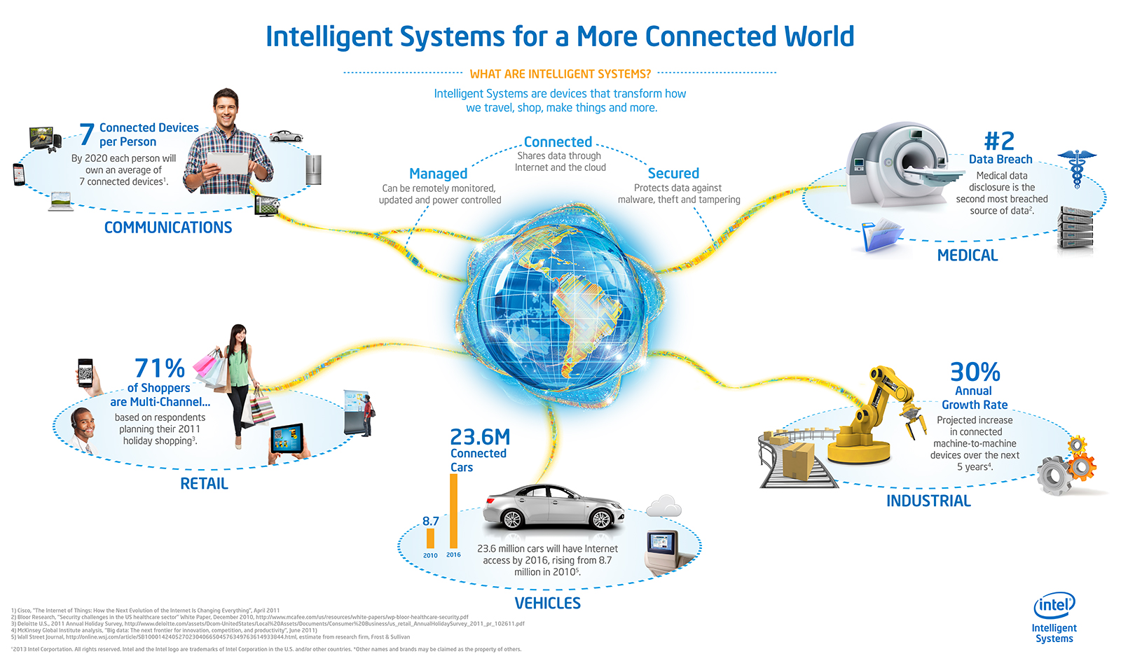
Opportunities
Source: http://blog.trentonsystems.com/internet-of-things-crosses-business-personal-boundaries/

Slide 45
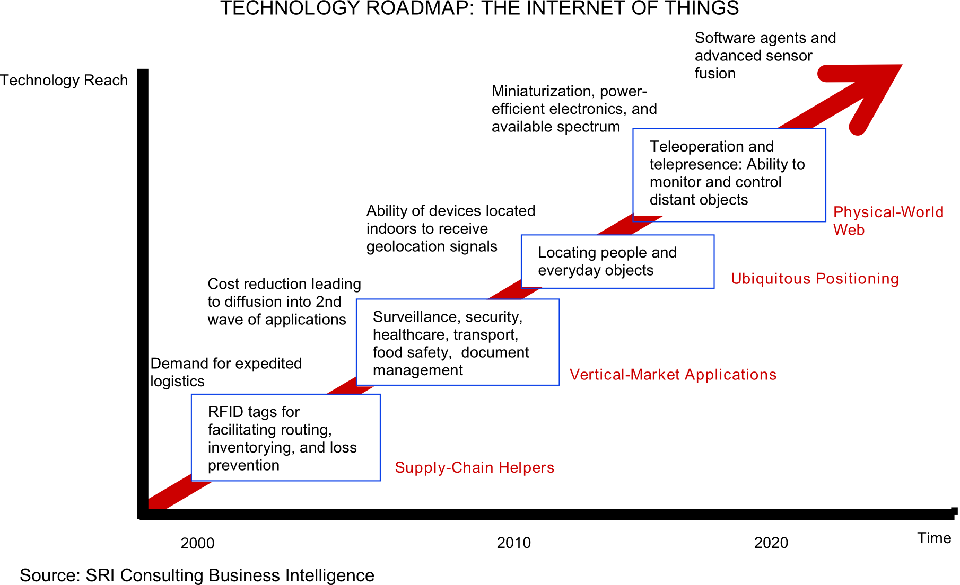
Technology trend

Slide 46
Market growth
“According to a study conducted by Frost & Sullivan in 2011, the global RFID market of $3 billion to $4 billion (in 2009) will grow by twelve percent per year through 2016 and reach a volume of approximately $6.5 billion to almost $9 billion.”
80 percent of all households in the European Union are expected to have intelligent power meters by 2020.
A building’s energy management can then be monitored and administered remotely via a smartphone or a PC. Market experts predict that this global market, which represented $5.3 billion in 2010.
In February 2012 the Chinese government therefore decided to set up a fund of approximately $775 million to support this field in the next five years. It will grow to $11 billion by 2015.
  This sector is expected to grow to $116 billion by 2015, according to a report published by the Xinhua News Agency in late 2010.
Source: Siemens, http://www.siemens.com/innovation/apps/pof_microsite/_pof-fall-2012/_html_en/facts-and-forecasts-growth-market-of-the-future.html

Slide 47
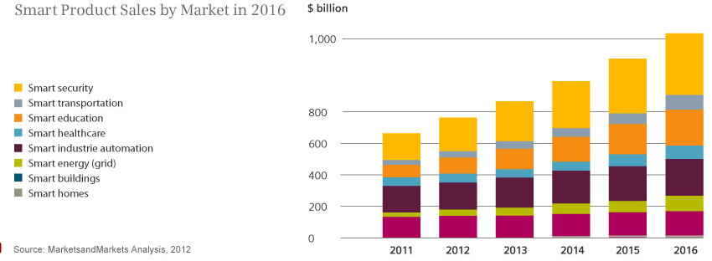
Smart product sales
Source: Siemens, http://www.siemens.com/innovation/apps/pof_microsite/_pof-fall-2012/_html_en/facts-and-forecasts-growth-market-of-the-future.html

Slide 48
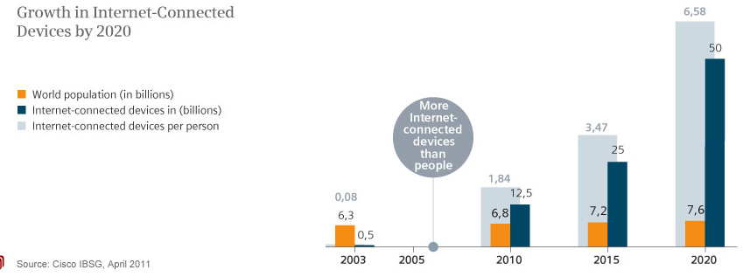
Internet Connected devices
Source: Siemens, http://www.siemens.com/innovation/apps/pof_microsite/_pof-fall-2012/_html_en/facts-and-forecasts-growth-market-of-the-future.html

Slide 49
Global Data Generation
Everyday around 20 quintillion (10^18) bytes of data are produced (Source: http://www-01.ibm.com/software/data/bigdata/).
- This data includes textual content (unstructured, semi-structured, structured) to multimedia content (images, video and audio), on a variety of platforms (enterprise, social media, and sensors).

Slide 50
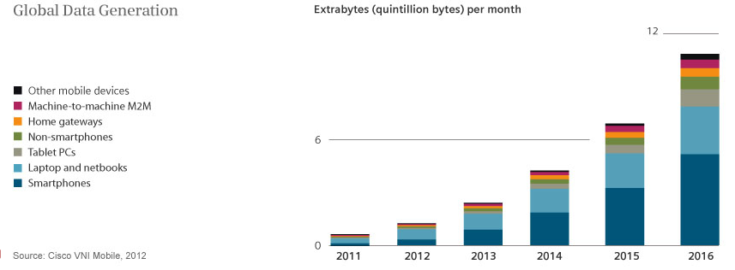
Data Generation

Slide 51
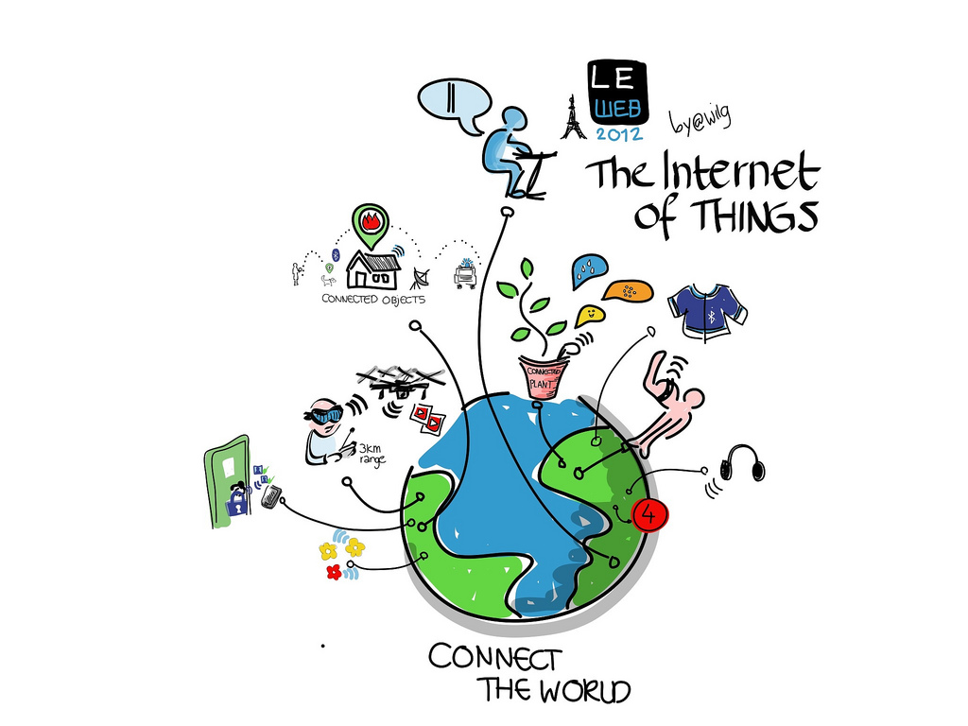
Internet of Things
Image courtesy: Wilgengebroed

Slide 52
Interesting Topics
Cyber-Physical systems, smart devices, sensors and actuators
Key applications, protocols and architectures
Networks and Communications (Wireless Multi-hop Networks (WMN), Mobile Ad-hoc Networks (MANET), Wireless Sensor Networks (WSN))
Reliability, Security, Privacy and Trust issues and solutions
Software platforms and services
Intelligent Data Processing and Semantic technologies
Connecting things to the Web
Applications, system models, Standards, and Physical-Cyber-Social systems

Slide 53
Some of the related material
Reading List:
  http://aspire.surrey.ac.uk/lists/35640FC8-892D-E309-E66C-F07C3D9BCB28.html
ETSI, Machine to Machine Communications
  http://www.etsi.org/technologies-clusters/technologies/m2m
Machine-to-Machine Communications, OECD Library,
  http://www.oecd-ilibrary.org/science-and-technology/machine-to-machine-communications_5k9gsh2gp043-en
W3C Semantic Sensor Networks
  http://www.w3.org/2005/Incubator/ssn/XGR-ssn-20110628/

Slide 54
Q
A
&

Slide 55
Assignment #3
  Answer the Question in Red on Slide 21 with reference to source of information
  Explain the terms highlighted in Red in Slide 39

